Slide 1


SMARTBUY
Sprint 10 Mockups
Presentations prepared by
BA collaboratively with designer.

Slide 2

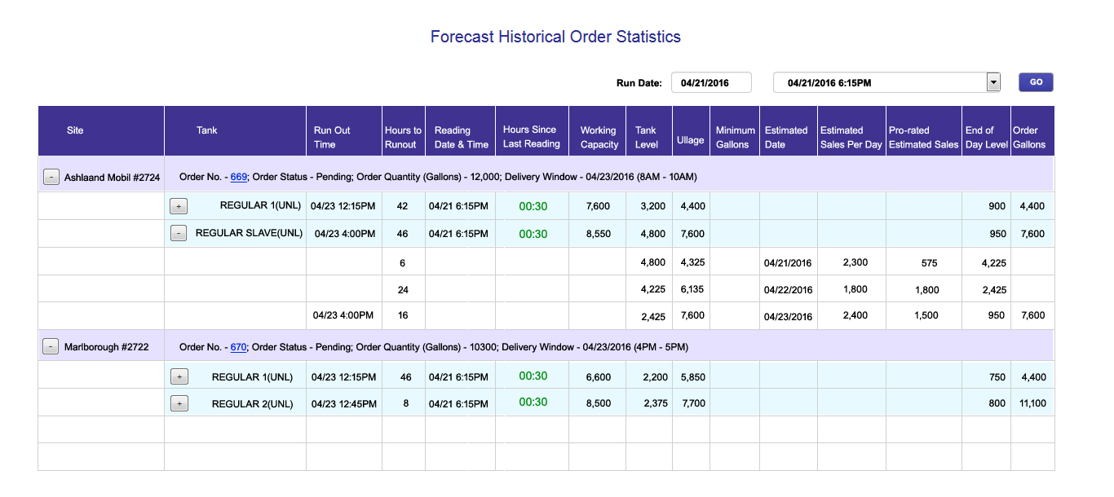
Tank Runout Dashboard
Ullage = Working capacity – End of day level.

Slide 3
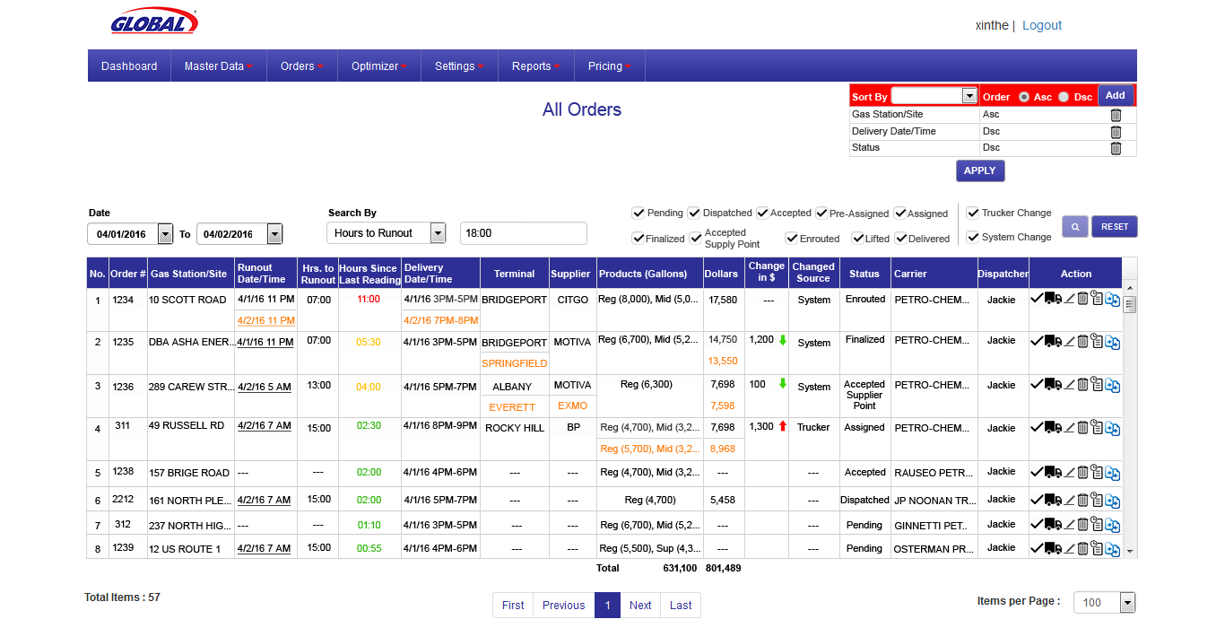
Dispatcher View Of List Screen
When the cost goes up there is red up arrow, when the cost goes down there is a green down arrow
For Manual and Scheduled orders, there will not be runout

Slide 4
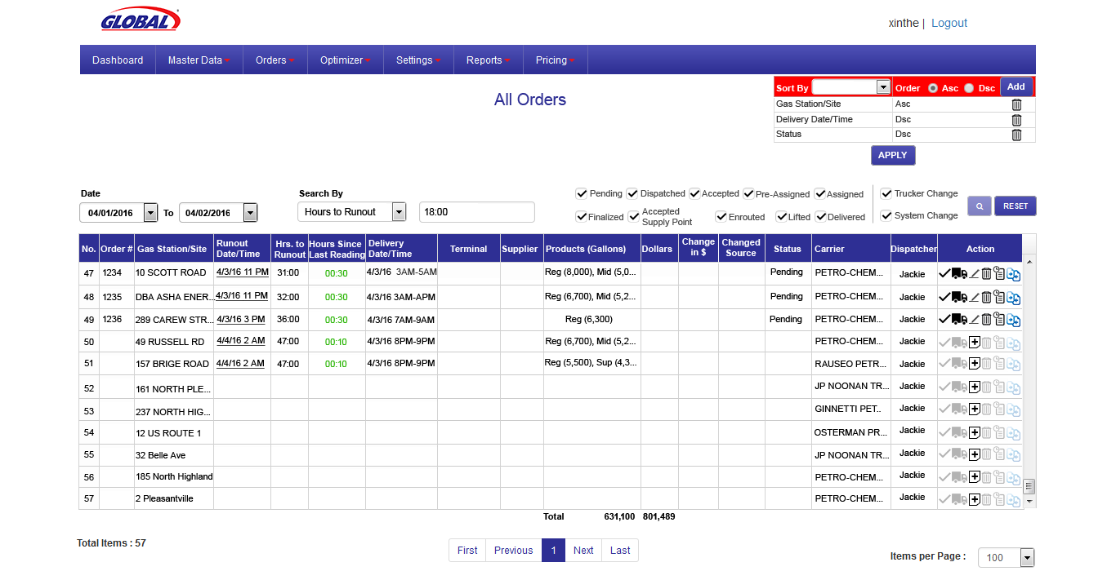
Dispatcher View Of List Screen
dispatcher will see all sites sorted by run out date/time. Sites without orders will be in the list too
To view the orders filtered by sites running out in next 18.00 hrs
Sites without Tank Monitors (insite360) DOS/DTW only the name of the site and the primary carrier would be displayed
When a file is received from insite360, runout time is computed for all the sites we get a inventory reading for, even for the sites which the runout time is outside the window on the order generation config screen
For the sites with no orders, edit icon will replaced by + add icon. Clicking on add will open order entry screen

Slide 5
Dispatcher generates orders using
“Order Generation Configuration” screen

Slide 6
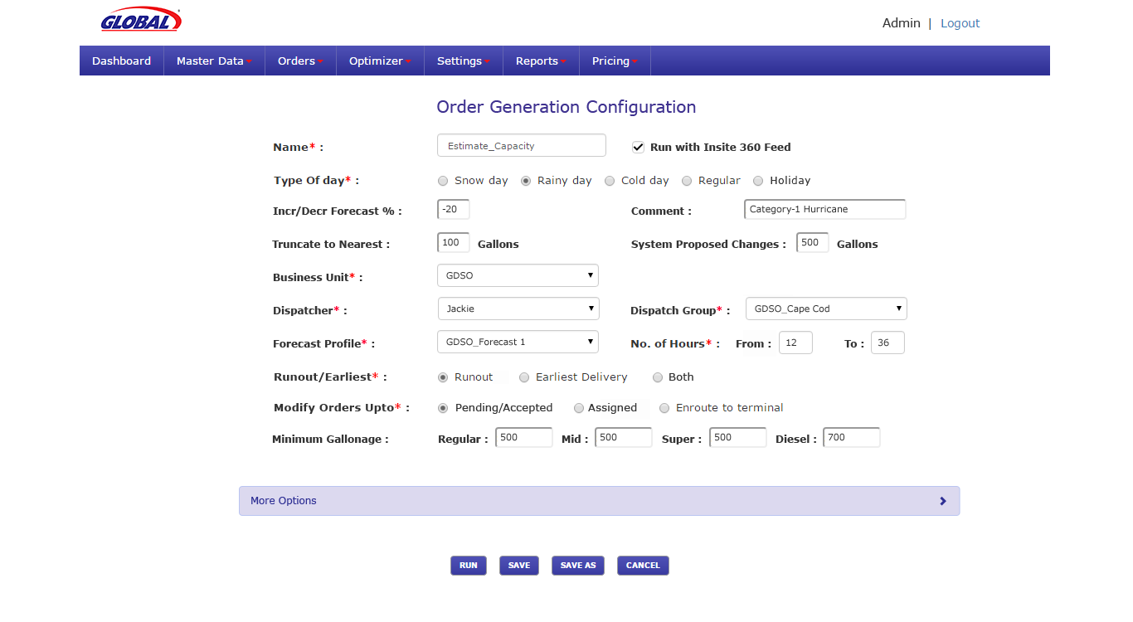
Order Generation Configuration
When checked, the saved configuration will run automatically when Insite360 file is received and processed. No manual intervention is required
When runout volume is forecasted, the volume will be truncated to the value entered in this text box. If the runout is predicted to be 2182, this will be truncated to 2nearest 100 i.e. 2100
System proposed changes on gallonage should be made only if there is an overall change of +/-500 gallons or more at a product level or over all load level.
Most terminals have a minimum gallonage that can be lifted by product

Slide 7
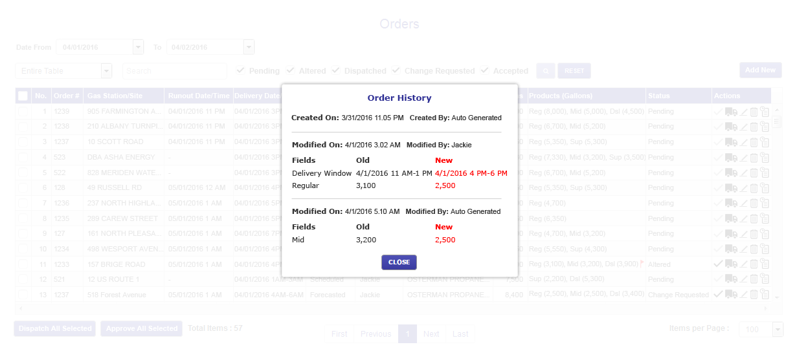
History Popup When Clicked On History Icon
Here, the order has been through 2 changes which can be seen as 2 separate entries.

Slide 8
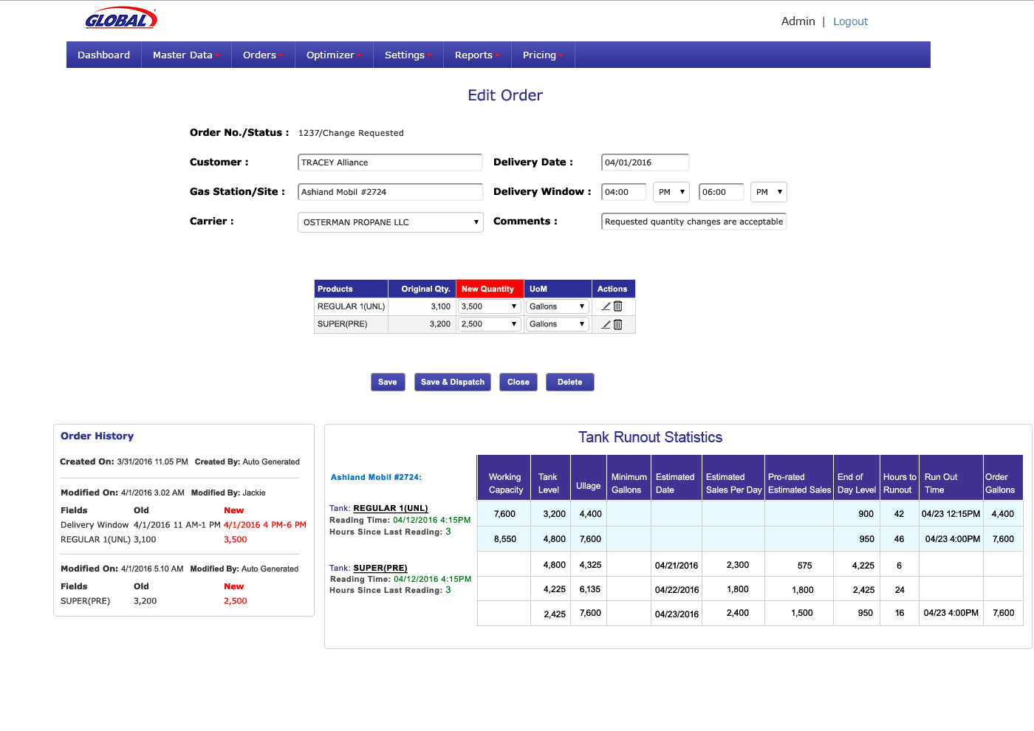
Edit Order Screen

Slide 9
Carrier either accepts or requests for changes through Carrier Order List screen

Slide 10
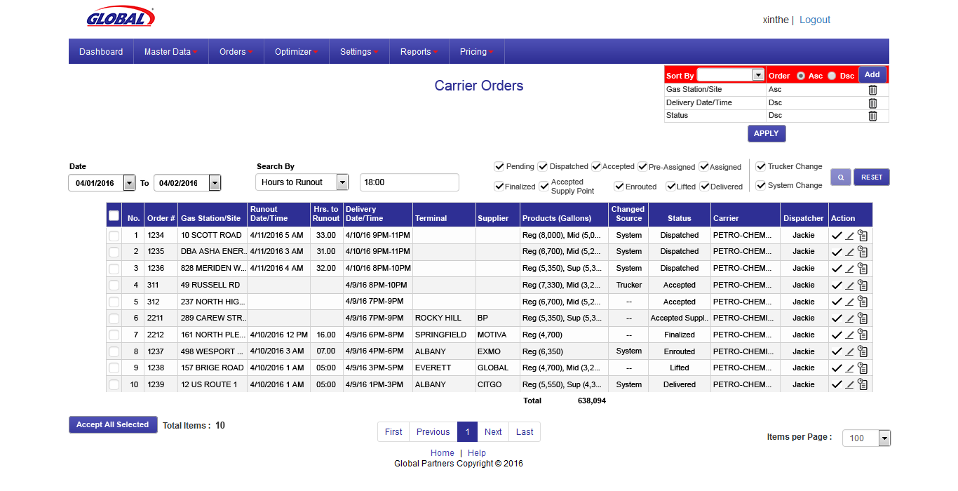
Carrier Order list screen

Slide 11
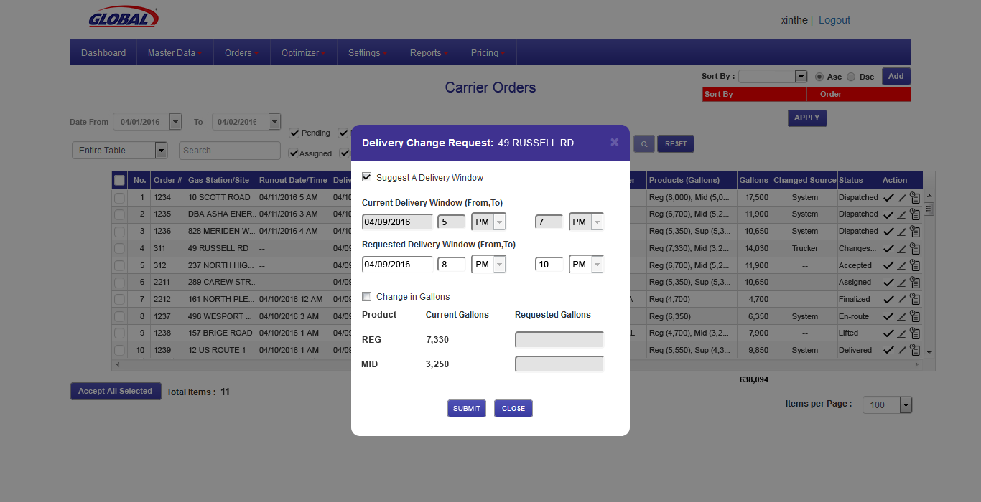
Carrier Change Request
Carrier can request for change by suggesting a new delivery window or change in gallons

Slide 12
Dispatcher runs Optimizer in Hedge Mode

Slide 13
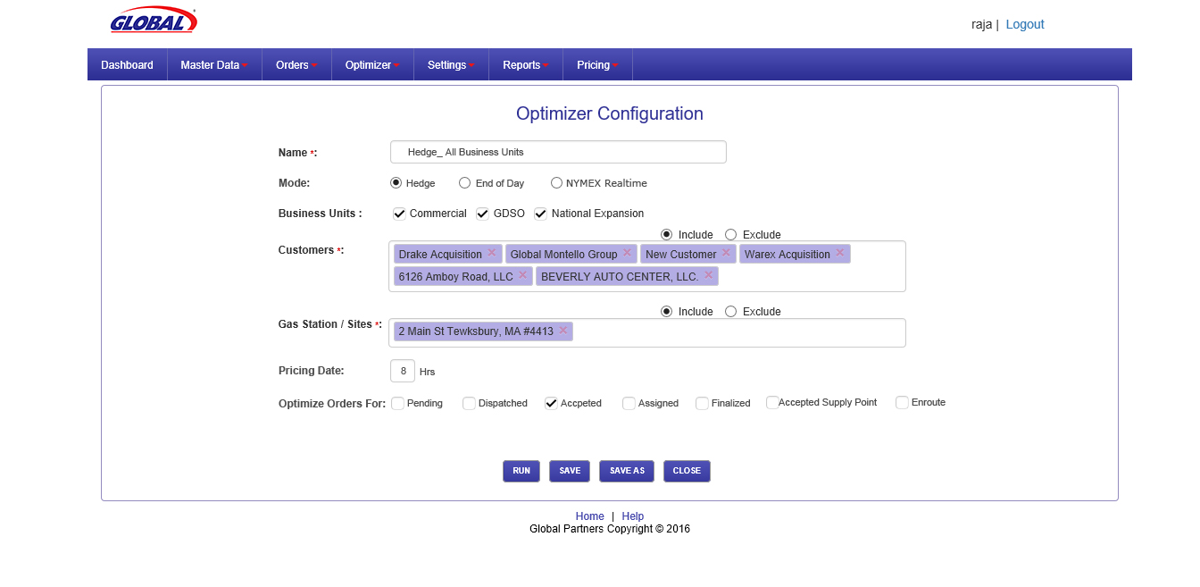
Configure And Run Optimizer in Hedge Mode
Optimizer can be run in 3 modes.

Slide 14
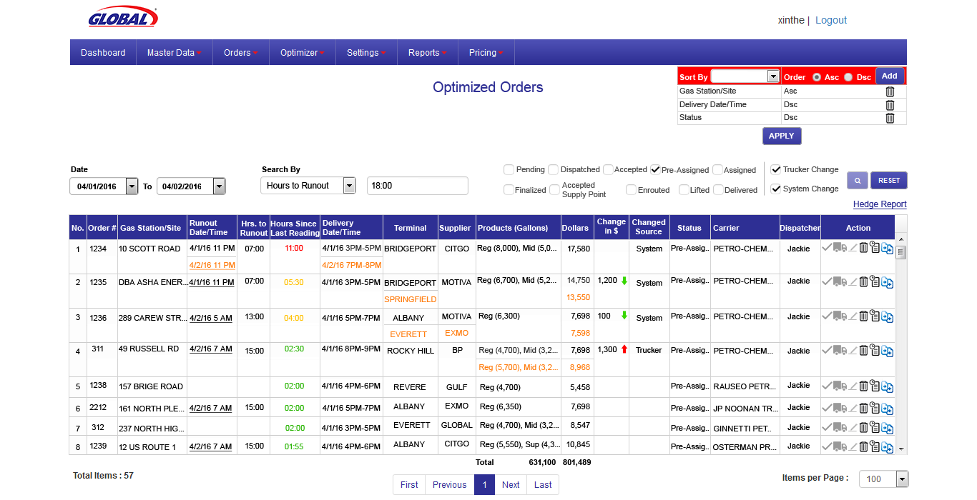
Hedge Mode Results
When optimizer is run in hedge mode, it will compute the Global Gallons and 3rd Party Gallons. Global Gallons will be the basis to ‘Unwind the Hedge”. The status will be in pre- assigned
Clicking on Hedge Report link, a report in a popup will be shown

Slide 15
Global Unwinds the Hedge or put the Hedge Back as per the Hedge Report

Slide 16
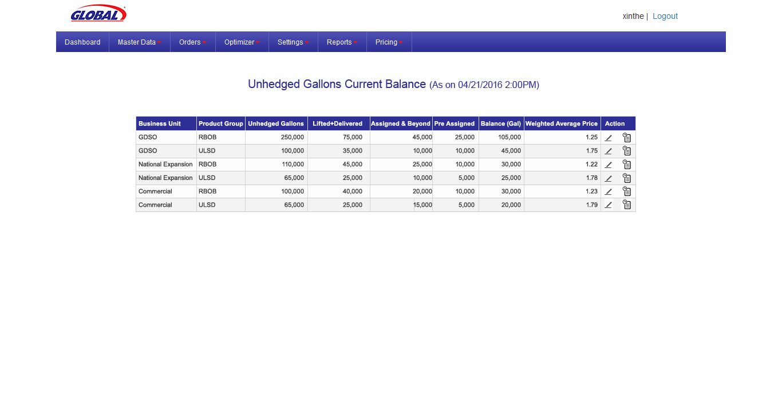
Unhedged Gallons Report

Slide 17
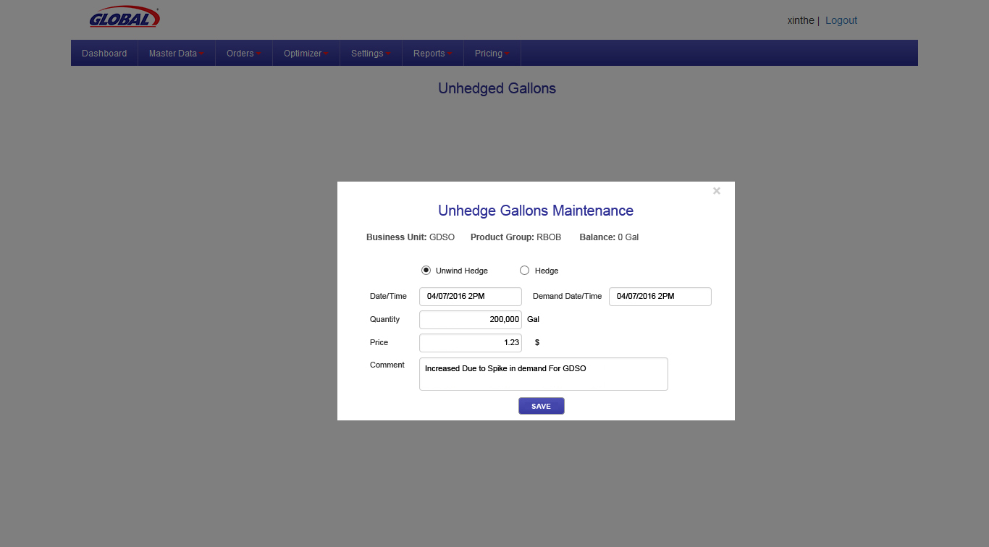
Unhedged Gallons Maintenance
Global user will input the unwind hedge or Hedge

Slide 18
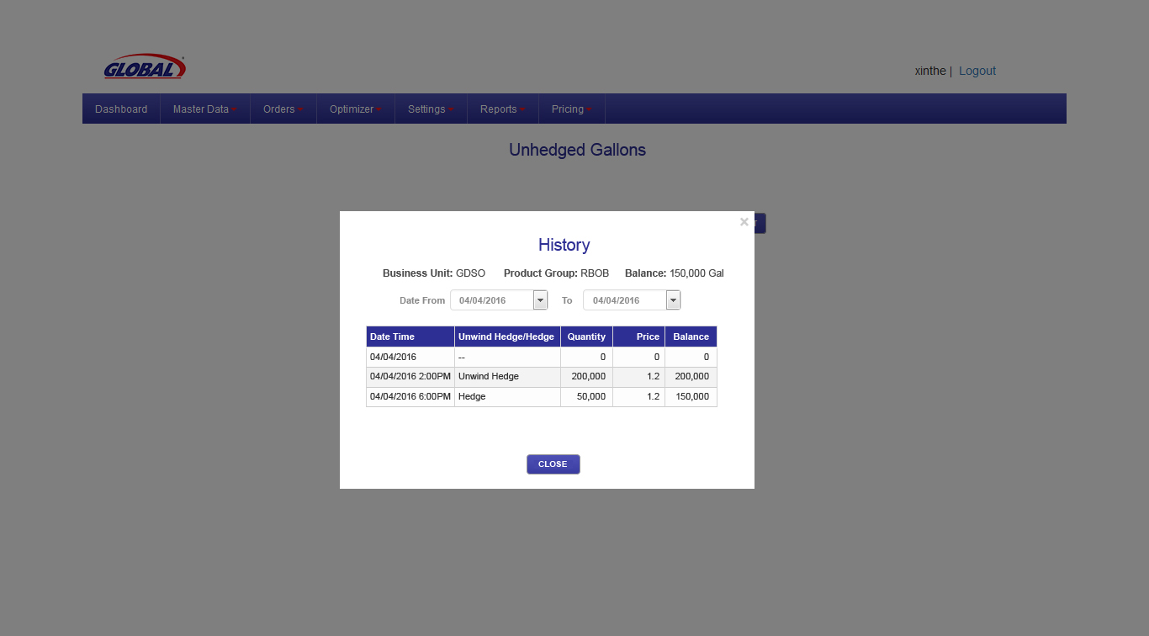
Unhedged Gallons History
In this illustration, Initial balance was zero and at 2.00pm, Global has unwinded hedge for 200,000 gallons and at 6.00pm, hedged backj 50,000. The balance can be seen as 150,000

Slide 19
Optimizer Runs in End Of Day & NYMEX Real-time Mode

Slide 20
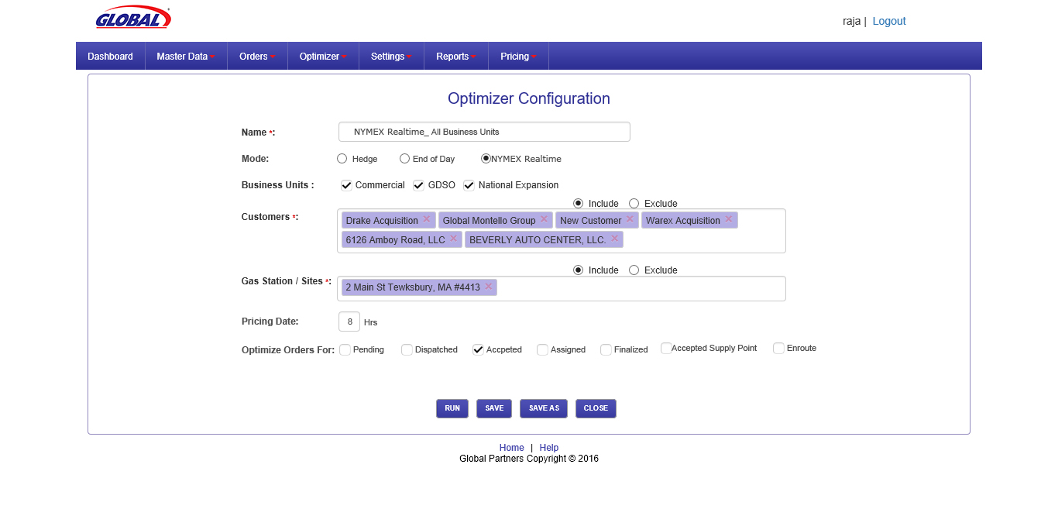
Configure and Run Optimizer in Real Mode
Optimizer is run in Nymex real time mode
Here the user can configure in which statuses orders can be optimized.

Slide 21

Optimized Orders – End Of Day & Nymex Real Mode
Nymex real time mode is run at 10am next day to gain on the changing prices and Supplier & Terminal combination will be re assigned till the order status is in Enroute to terminal status.
When optimizer is run in End Of Day mode, the status will be changed to assigned. Carriers will be assigned with supply point.

Slide 22
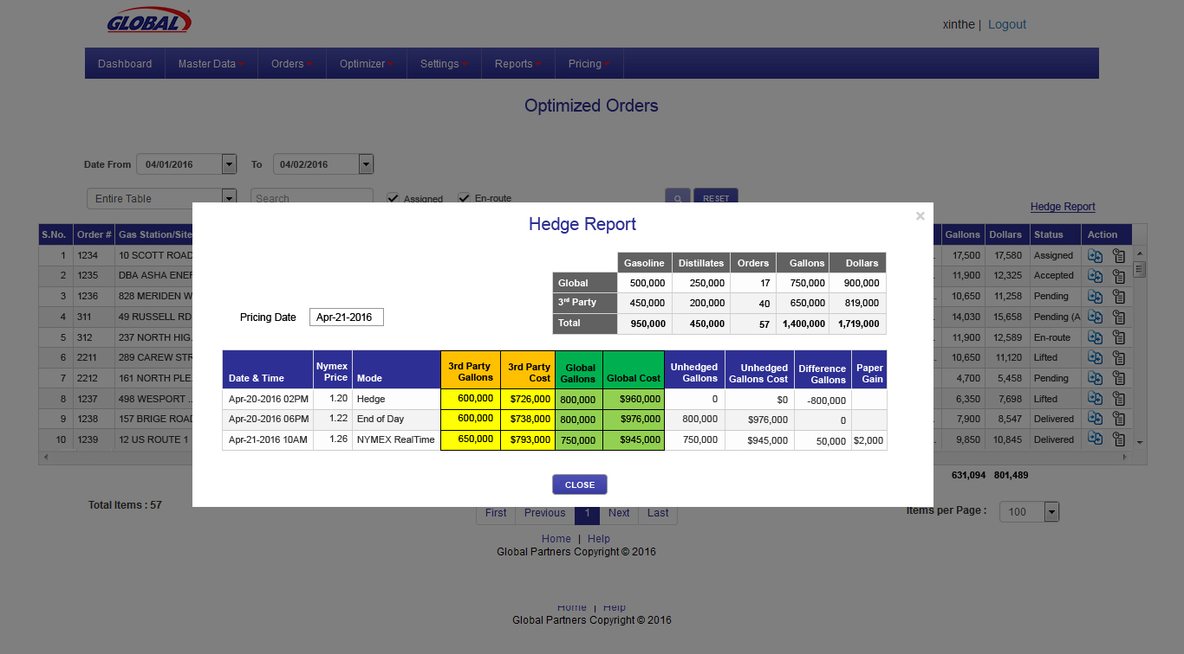
Hedge Report

Slide 23
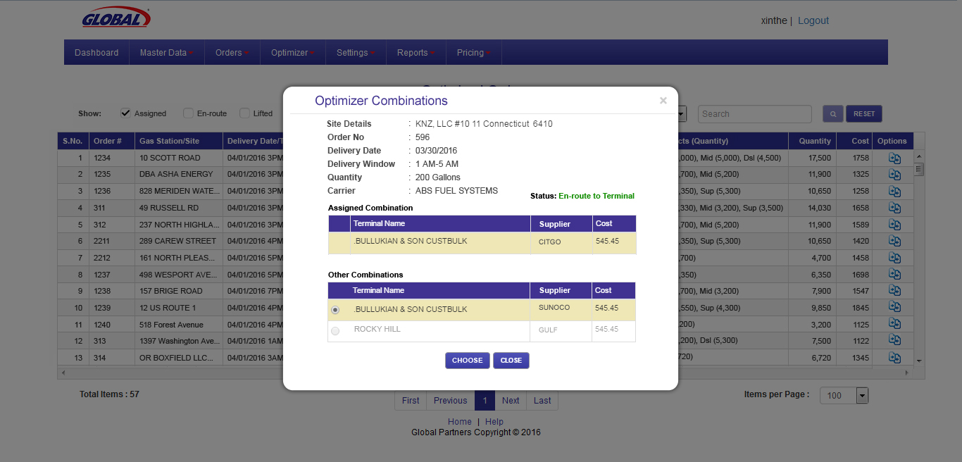
Optimized Orders – En- Route To Terminal Popup
In the En-route to terminal status, supply point can be changed to another point within the port geography.

Slide 24
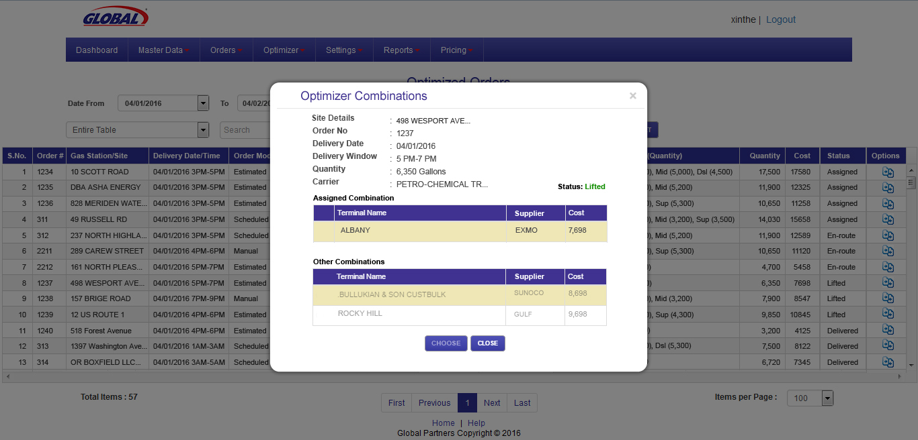
Optimized Orders – Lifted- Popup
In the lifted status, supplier point cannot be changed.

Slide 25
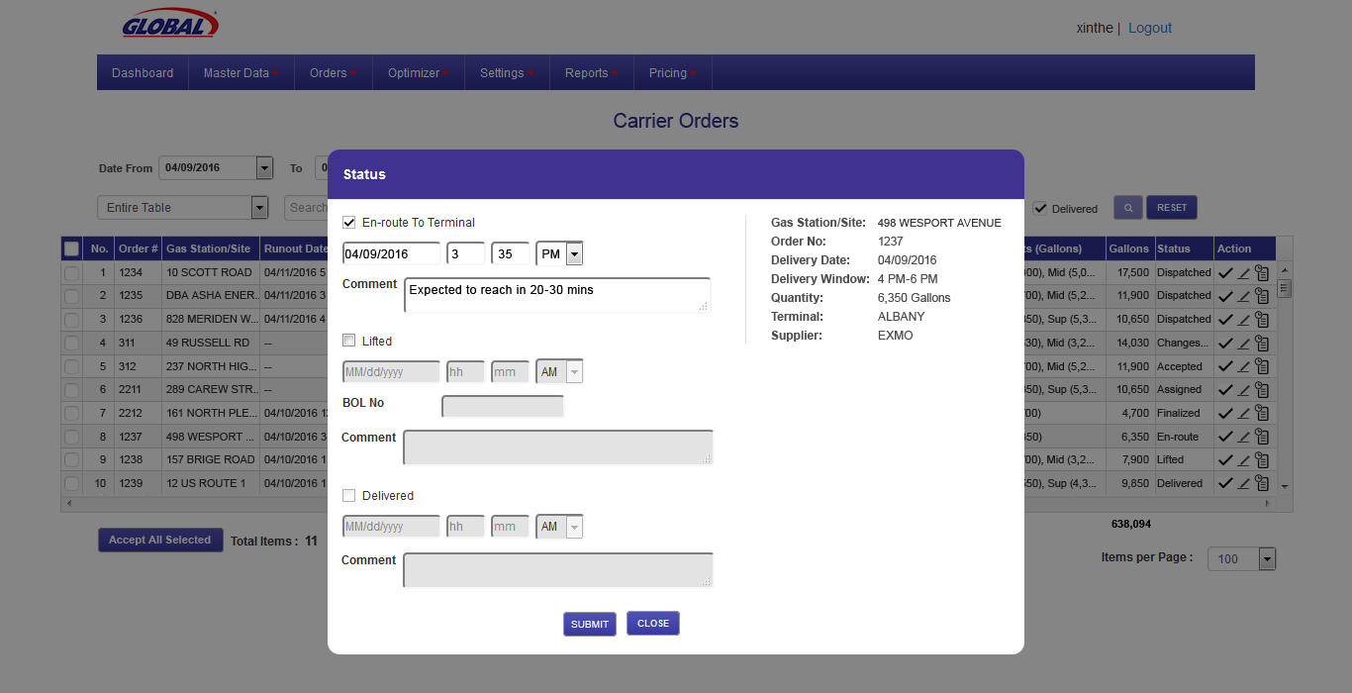
Carrier Status Update – En-route To Terminal
Carrier updates his status starting with En-route to terminal to next statuses

Slide 26
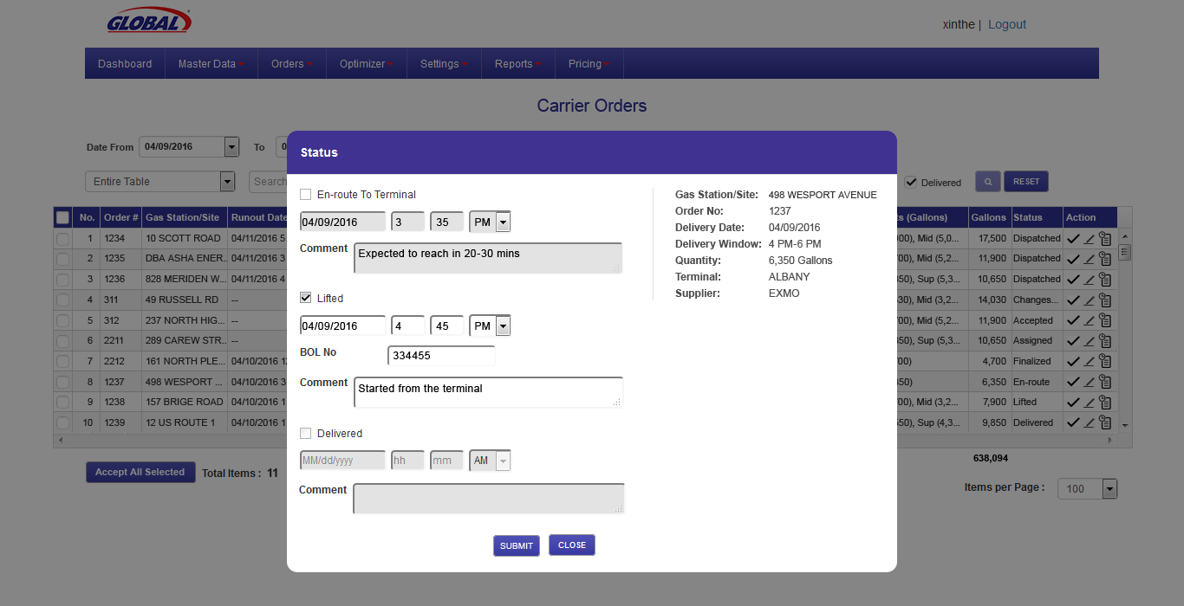
Carrier Status Update - Lifted

Slide 27
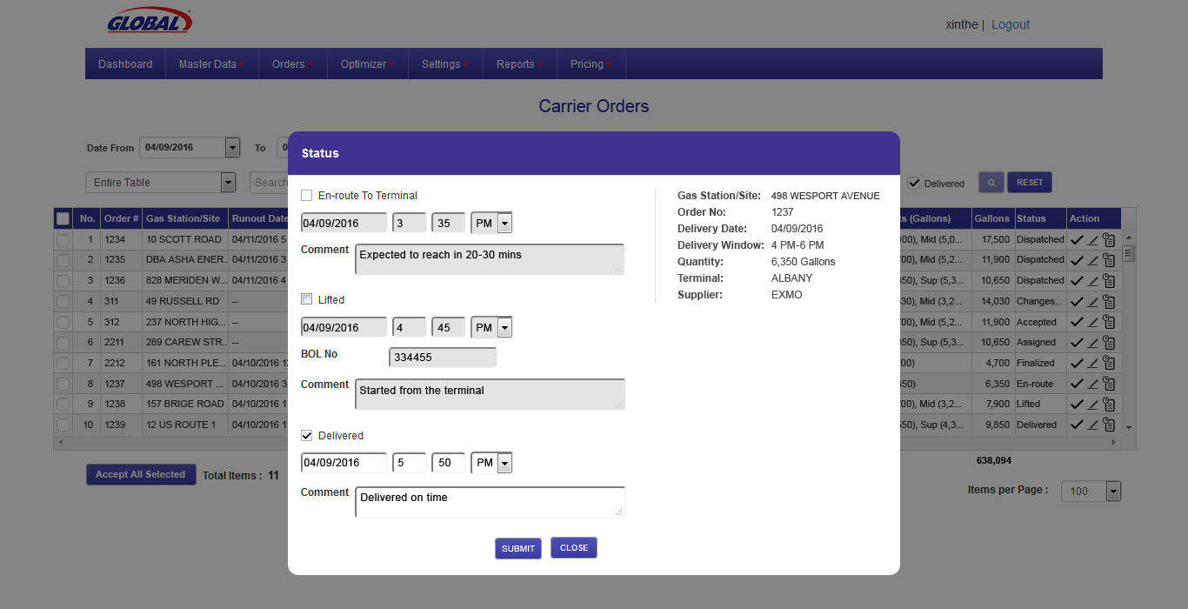
Carrier Status Update - Delivered

Slide 28
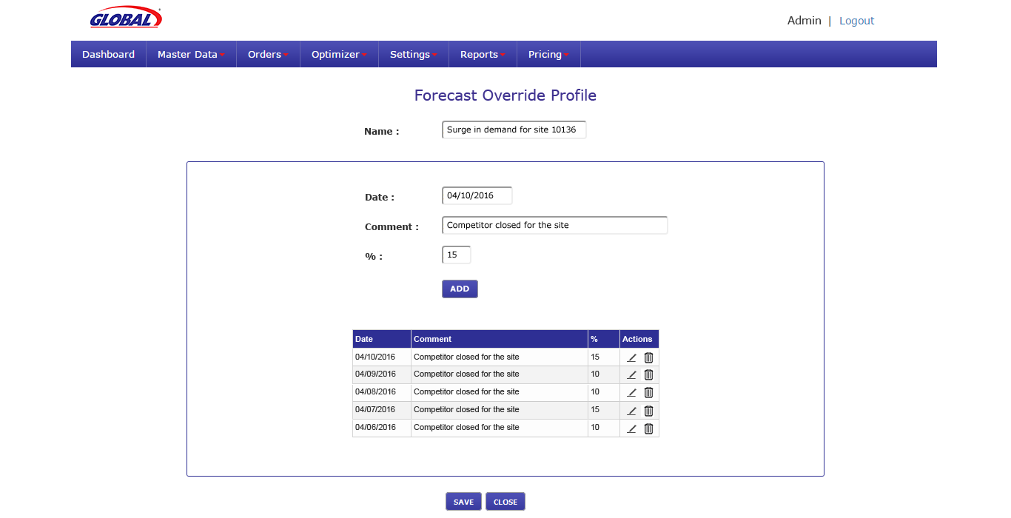
Configure Forecast Over Ride Profile
Configure Forecast Over Ride Profile (Surge in Demand). This Profile will be assigned at site level which will override the generic Forecast profile

Slide 29
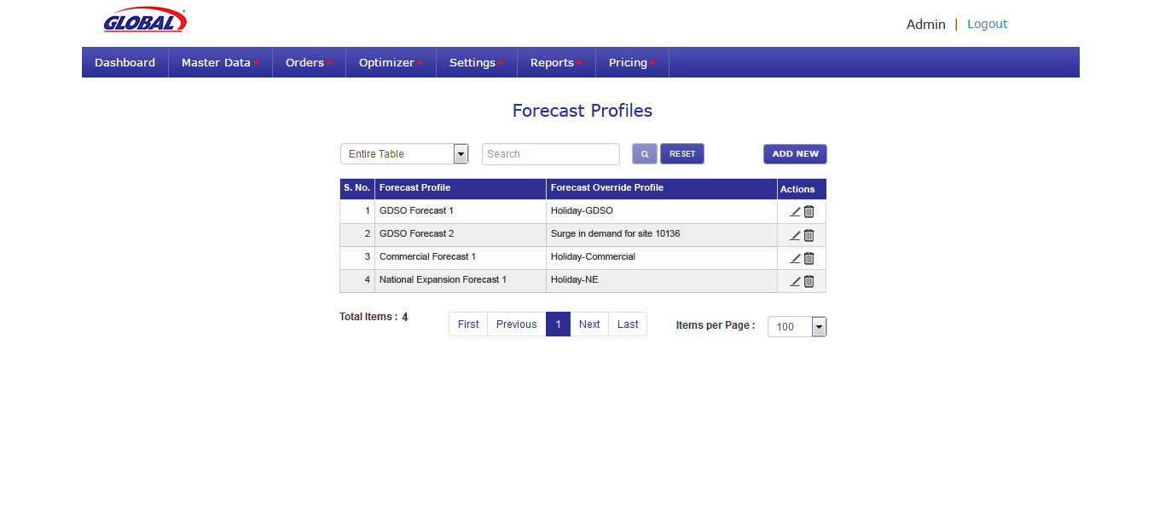
Forecast Over Ride Profile – List Screen

Slide 30
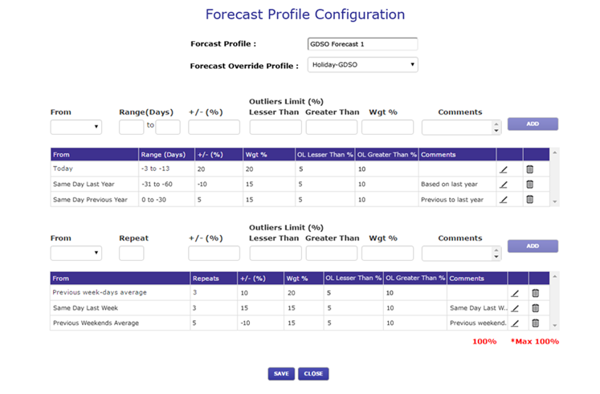
Configure Forecast Profile– Assign Forecast Over Ride Profile
Configure Forecast Profile and Forecast Over Ride Profile is assigned

Slide 31
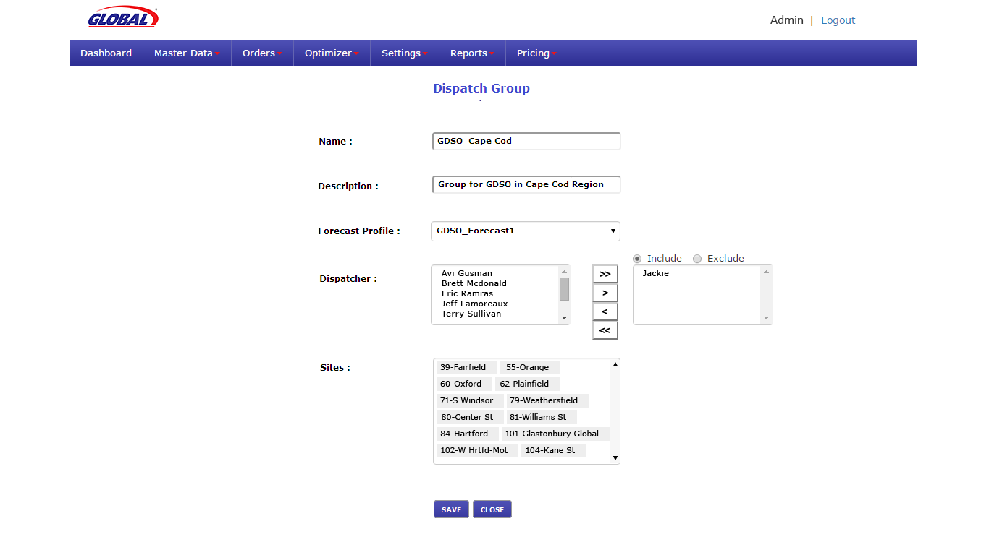
Dispatch Group Maintenance
Multiple dispatcher can be assigned to a dispatch group.

Slide 32
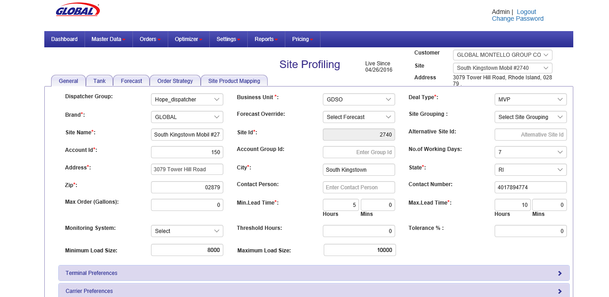
Site Profiling - Assign Dispatch Group And Forecast Override Profile, Setting Up Minimum & Maximum Trucker Load
Dispatch group is assigned to a site.
Minimum and Maximum load size a trucker can carry is setup. If the load is below the minimum, Penalty per load will be charged by the trucker.
Surge In Demand Forecast Override profile is assigned.

Slide 33
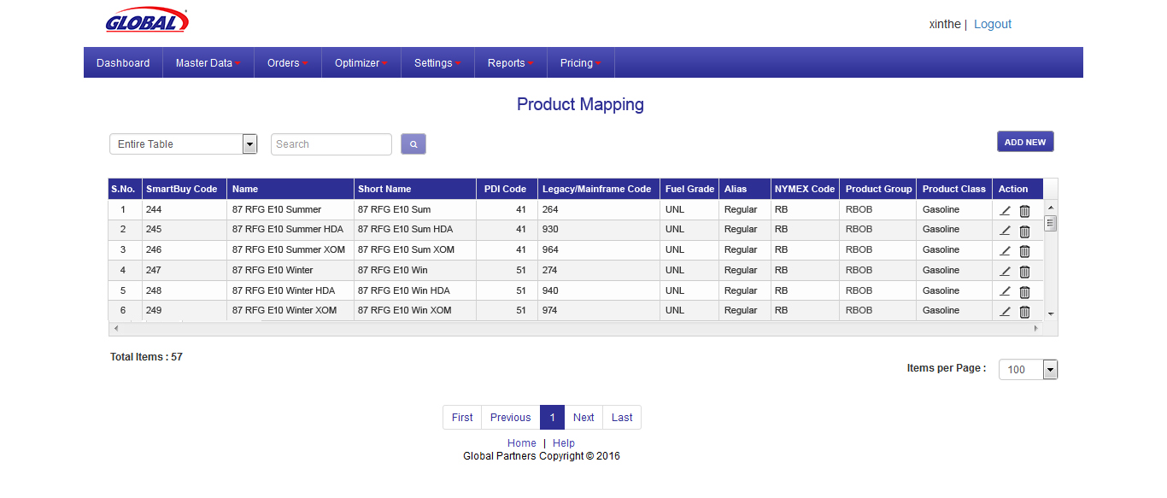
Product Mapping – List Screen

Slide 34
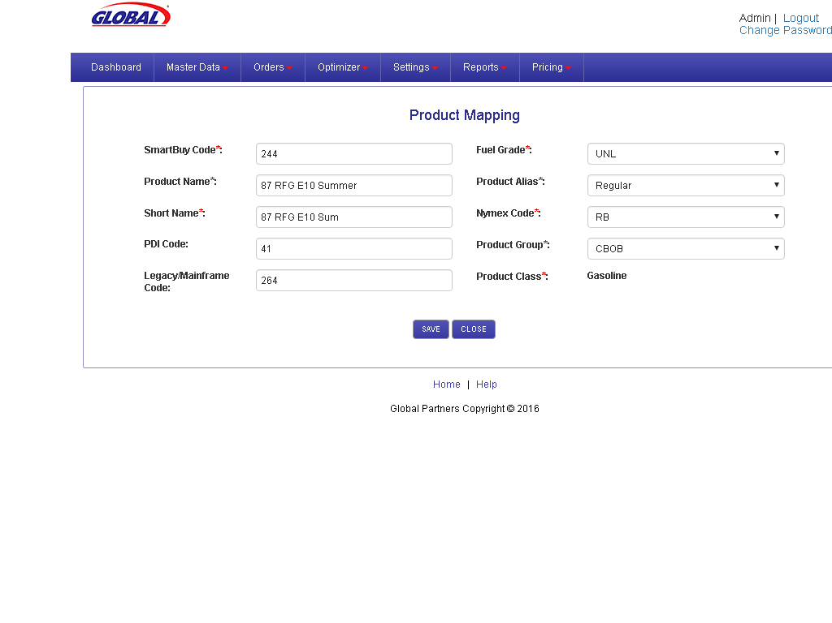
Product Mapping – Maintenance Screen

Slide 35
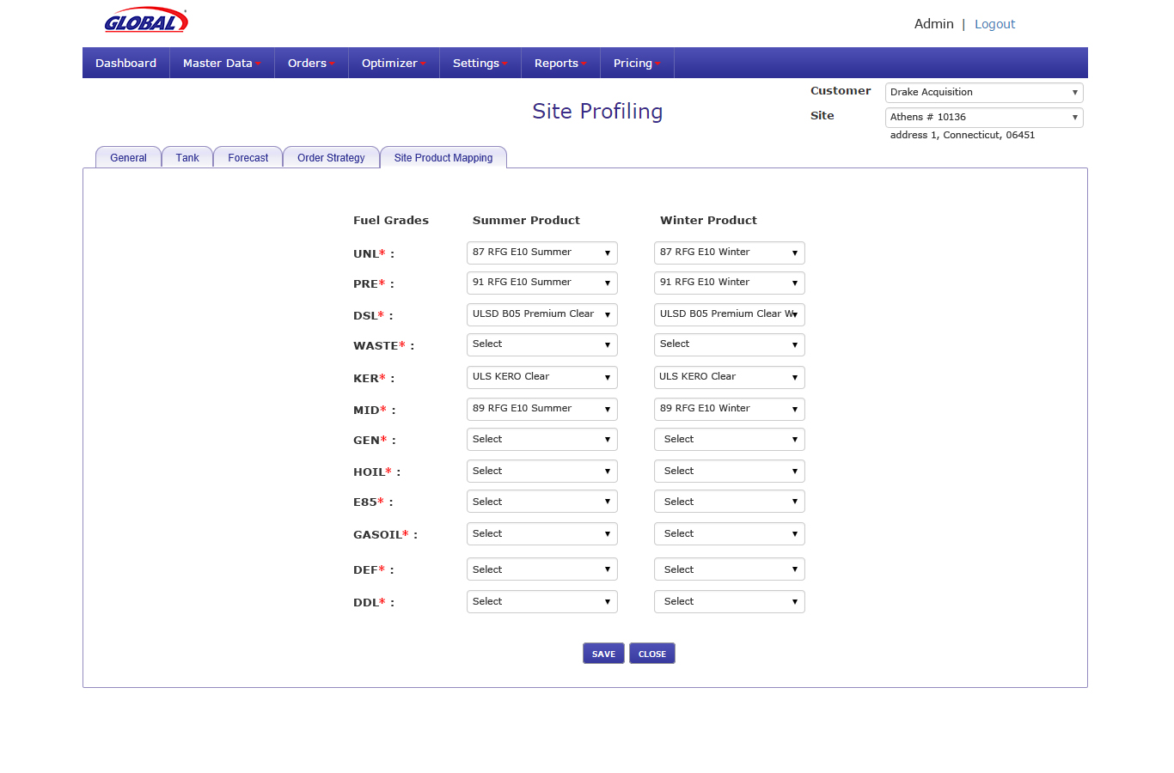
Site Profiling – Site Products Tab

Slide 36
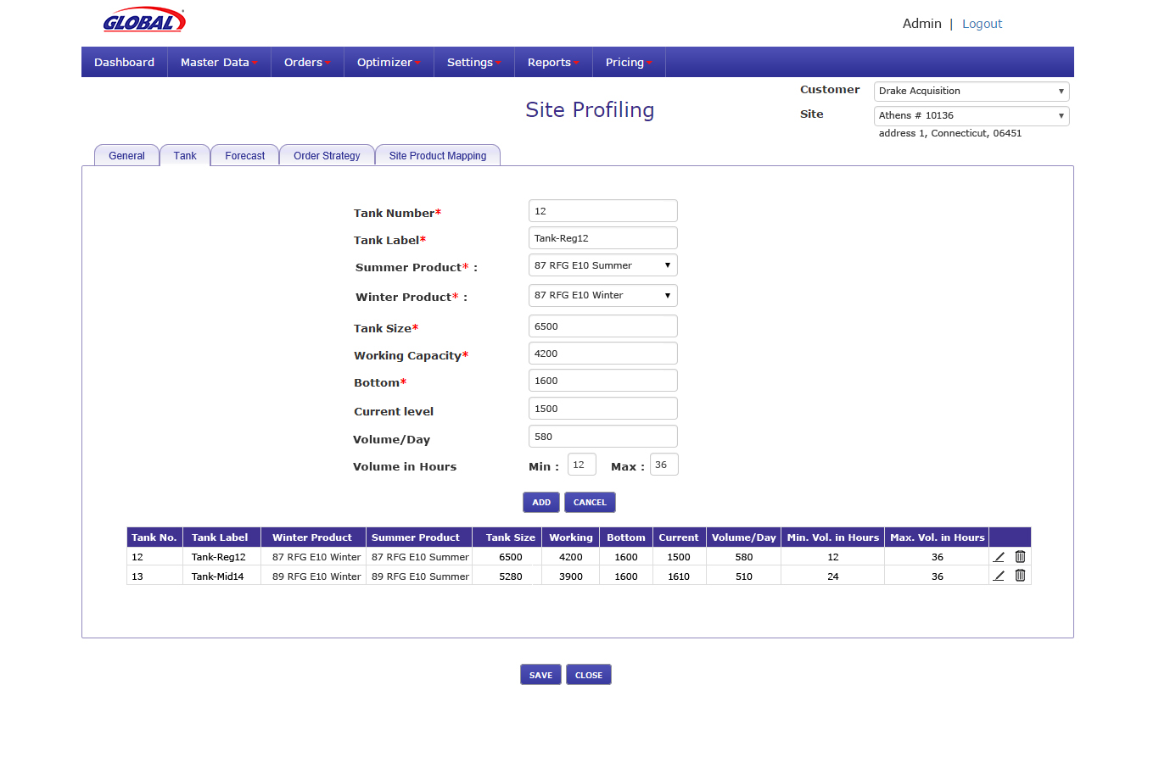
Site Profiling – Tank Tab

